Slide 1
Workshop 9 – Introduction of RL and Multi-armed Bandits
Advanced Analytics and Applications [AAA]
Information Systems for Sustainable Society (is3) | WiSo Faculty | Univ.-Prof. Dr. Wolfgang Ketter | 6/22/22

Slide 2
I
Multiple Choice Questions
II
Programming

Slide 3
AAA Workshop
Question 1.1: Reinforcement Learning
Which of the following is an application of reinforcement learning?
i. Topic modeling
ii. Recommendation systems
iii. Pattern recognition
iiii. Image classification

Slide 4
AAA Workshop
Question 1.1: Reinforcement Learning
Which of the following is an application of reinforcement learning?
i. Topic modeling
ii. Recommendation systems
iii. Pattern recognition
iiii. Image classification

Slide 5
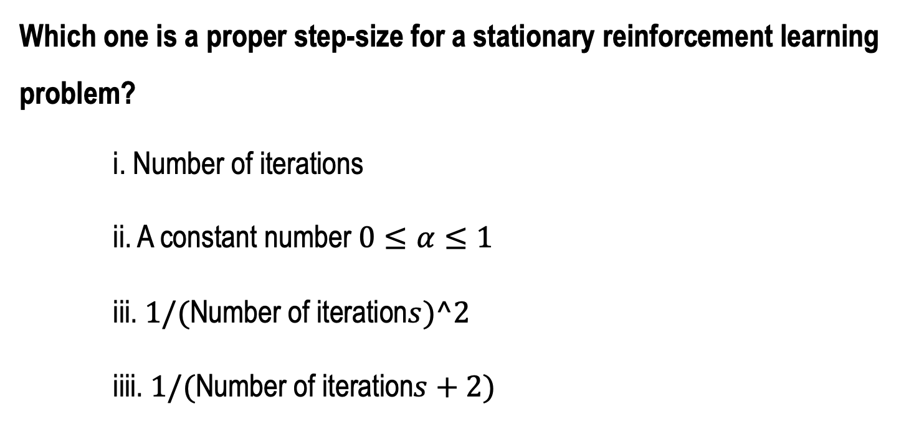
AAA Workshop
Question 1.2: Reinforcement Learning
Which one is a proper step-size for a stationary reinforcement learning problem?
i. Number of iterations
ii. A constant number $0≤α≤1$
iii. $1/(\text{Number} \text{of} \text{iteration}s)^2$
iiii. $1/(\text{Number} \text{of} \text{iteration}s+2)$

Slide 6
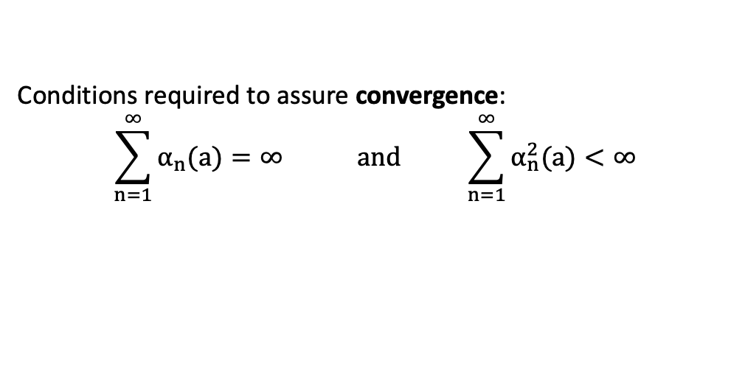
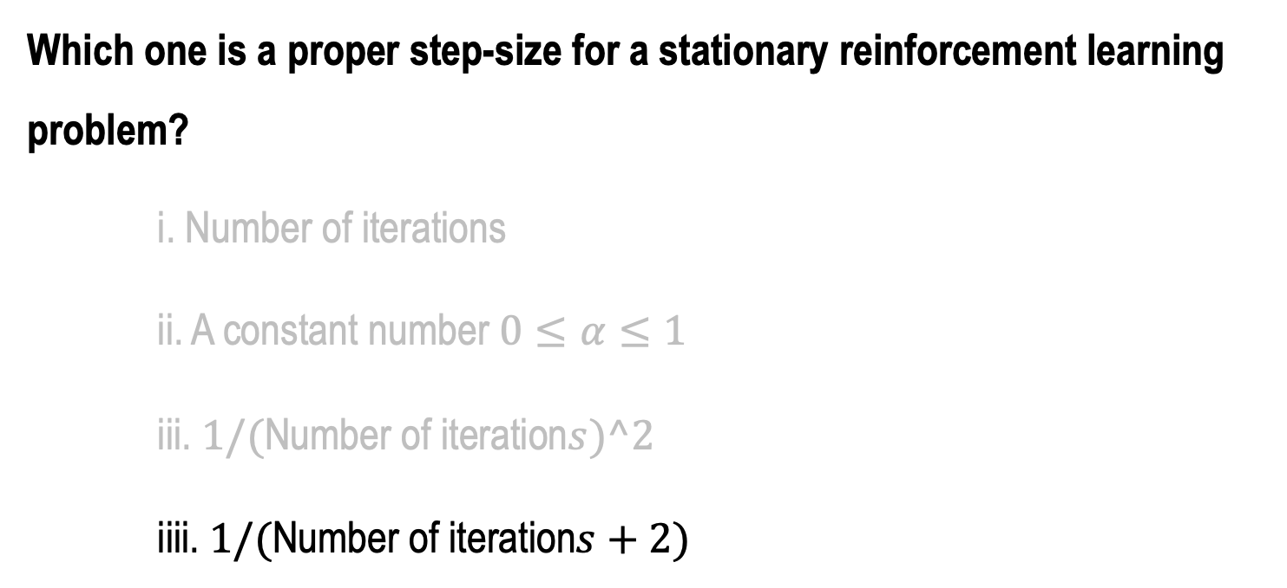
AAA Workshop
Question 1.2: Reinforcement Learning
Which one is a proper step-size for a stationary reinforcement learning problem?
i. Number of iterations
ii. A constant number $0≤α≤1$
iii. $1/(\text{Number} \text{of} \text{iteration}s)^2$
iiii. $1/(\text{Number} \text{of} \text{iteration}s+2)$
Conditions required to assure convergence:
$$\sum_{n=1}^{∞}{α_{n}(a)}=∞ and \sum_{n=1}^{∞}{α_{n}^{2}(a)}<∞$$

Slide 7
I
Multiple Choice Questions
II
Programming

Slide 8
AAA Workshop
Question 2: A Multi-armed Bandit program
Create a class of multi-armed bandits containing the following methods:
Initial attributes: number of arms, epsilon (Search probability), reward distribution (use a uniform function)
Action method (function): take action using an epsilon-greedy approach
Update method: updating the action values after each decision
Run method: iterating the MAB algorithm
Note: you need to keep track the count of each action and the mean reward

Slide 9
Contact
For general questions and enquiries on research, teaching, job openings and new projects refer to our website at www.is3.uni-koeln.de
For specific enquiries regarding this course contact us by sending an email to the IS3 teaching address at is3-teaching@wiso.uni-koeln.de

